Slide 1
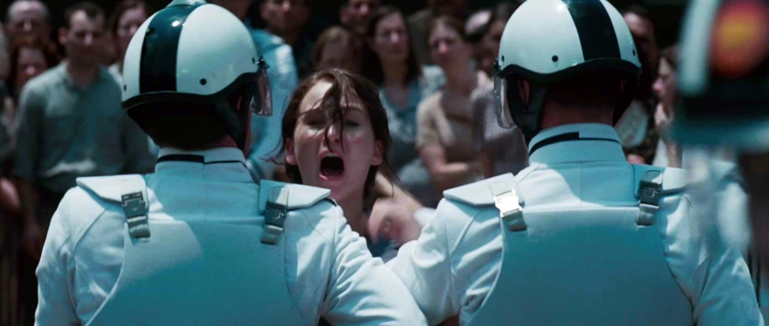

Starter
Imagine you write for a sensationalist tabloid newspaper.
Create a catchy headline to run alongside this image.
Challenge: Can you use alliteration in your headline?

Slide 2
Learning Objective
To recognise the features of a tabloid newspaper article.
To apply these features to create your own sensationalist news article.

Slide 3
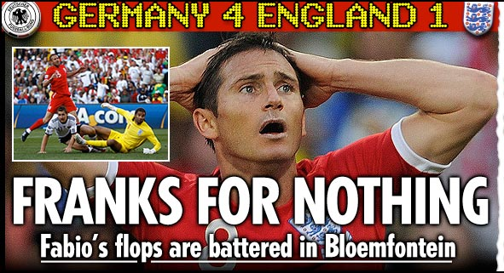
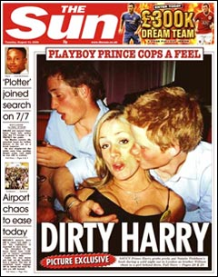

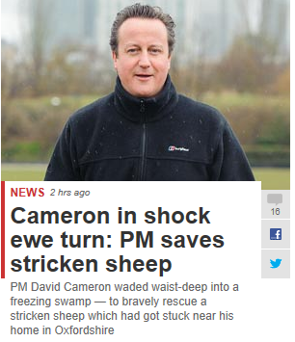

News headlines will often include the following techniques…
Puns
KEY WORD: A pun is a play on words for a humorous effect.

Slide 4
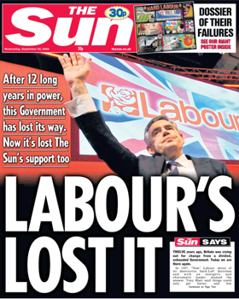
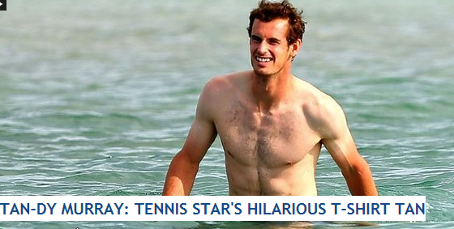
News headlines will often include the following techniques…
Alliteration
KEY WORD: Alliteration is when a number of words in a sentence have the same sound at the beginning.
What is the effect of alliteration? Why was it used?

Slide 5




News headlines will often include the following techniques…
Sensational or shocking language
Notes:
Discuss effect and additional techniques in these headlines

Slide 6
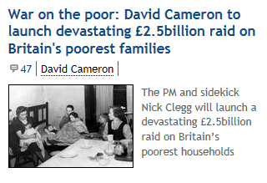

News headlines will often include the following techniques…
Emotional language

Slide 7



Sensationalistic Journalism:
Using Caesar’s interviews, create the first paragraph of a sensationalistic news report detailing the events. Work in Pairs.
Create a catchy headline, and write an engaging report about the event.
Your first paragraph should include the 5 Ws.
Ensure your report creates a strong impact upon the reader, detailing the facts in a sensationalistic manner.
Sentence Starters:
“The citizen’s of The Capitol were left reeling today when…”
“It looks like love could be in the air at this year’s Hunger Games when…”

